Slide 1
Introduction to Data Science
Concept of Data Science
Need of Data Science
Applications Of Data Science
Solving Simple Data Science Use Cases
Components of Data Science
Data Science Life Cycle (Understanding the Business Problem, Data Prep, EDA, Data Modelling, Model Evaluation, Model Deployment)
Market of Data Science
Understanding AI /ML/DL/NLP/CV/Data Science
Rise of Data Analytics
Types of Data Analytics
Data Analytics Lifecycle
Need for Business Analytics

Slide 2

Concept of data Science
What is Data Science?
Is Data Science a recent thing?

Slide 3
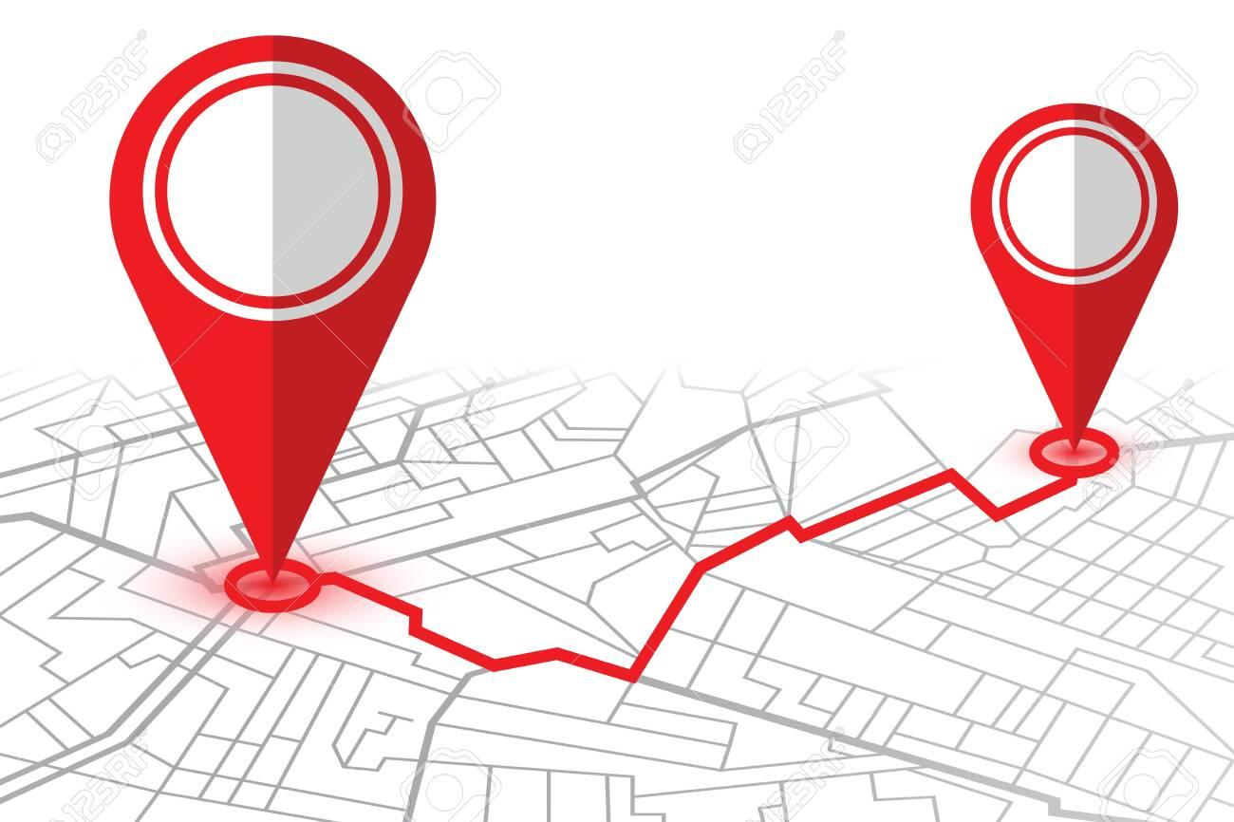
You travel from home to college, and you decide your departure time.
Mode of Commute | Arrival Time | Travel Time | Start Time
Car | 8:45 AM | 45mins | 8:00 AM
Car | 9:55 AM | 55mins | 9:00 AM
Bike | 8:30 AM | 30mins | 8:00 AM
Bike | 9:40 AM | 40mins | 9:00 AM
Public Transport | 9:15 AM | 75mins | 8:00 AM
Public Transport | 10:30 AM | 90mins | 9:00 AM
Predictive Analytics
A field of data analysis that uses historical data and statistical algorithms to make predictions about future events or outcomes.
Bike | 9:30 AM | ? | ?

Slide 4
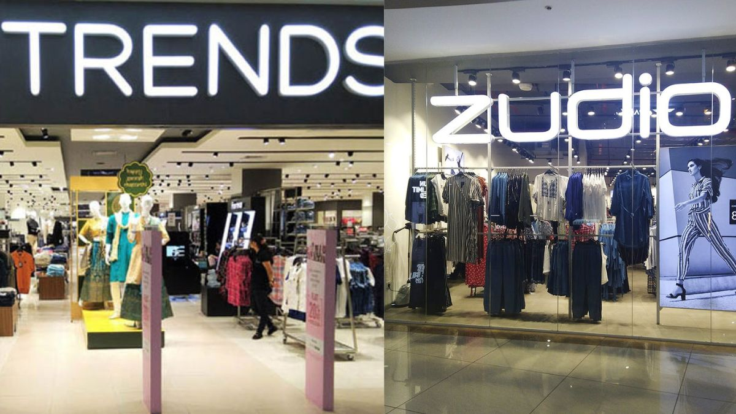
Decision Factors
Your past purchase experience
Proximity to store
Type of Purchase you want to make
Pricing and Discounts
Return and Exchange Policies
Shopping Experience
Predictive Analytics
A field of data analysis that uses historical data and statistical algorithms to make predictions about
future events or outcomes.

Slide 5
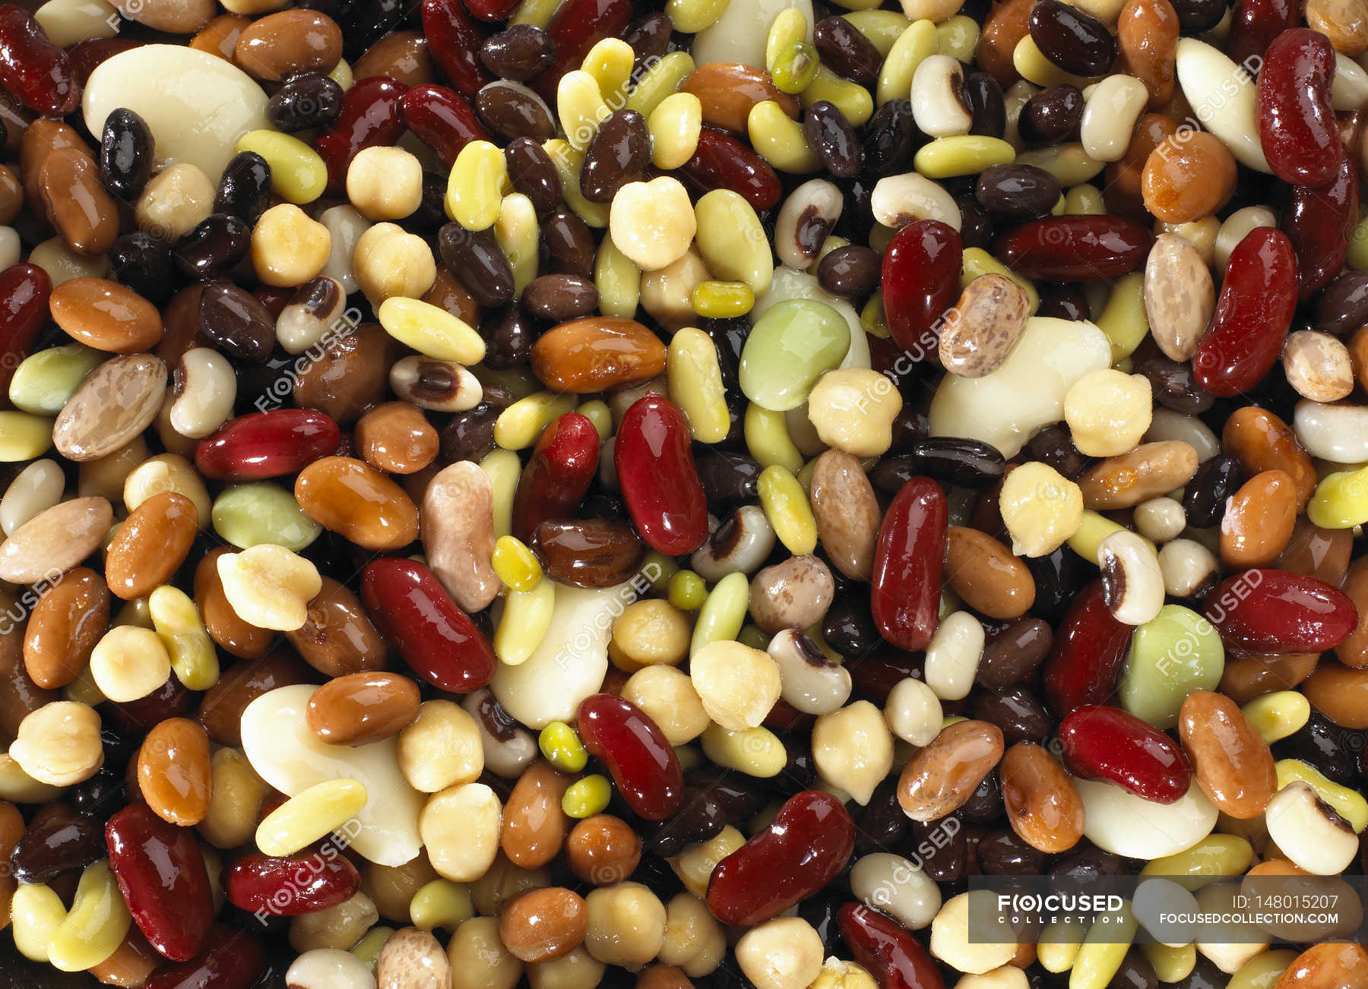
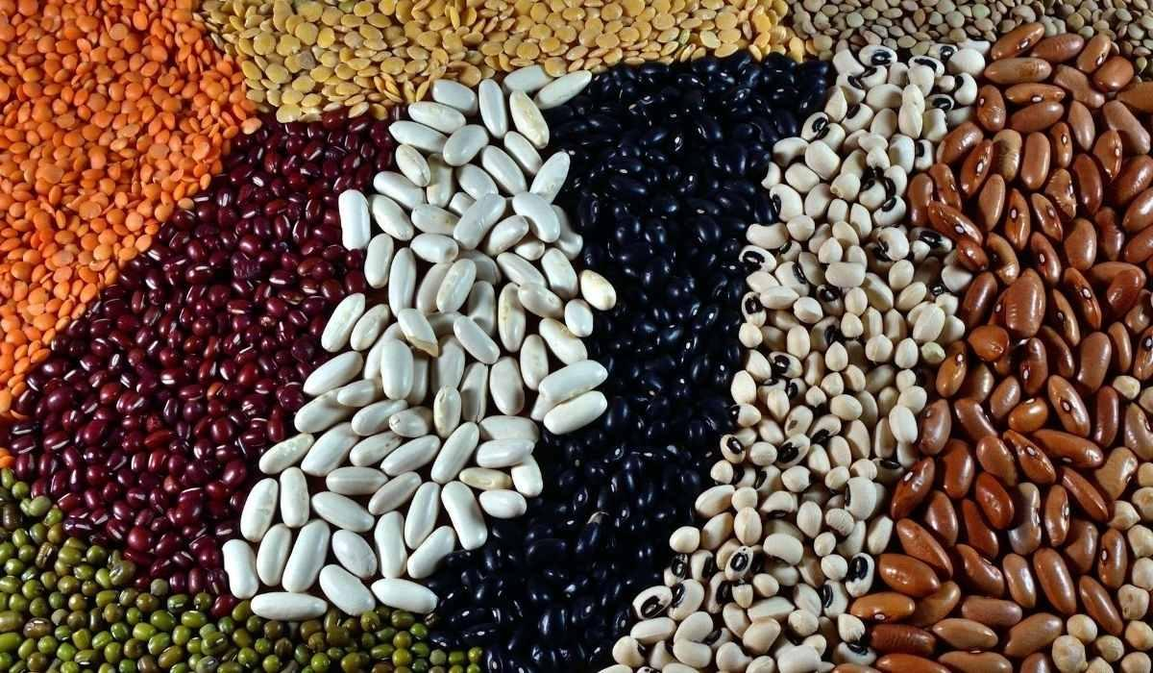
Decision Factors
Shape
Color
Weight
Size
Texture
Clustering
Clustering is a machine learning and data analysis technique used to group similar data points together based on certain characteristics or features they share.

Slide 6

^{3 Idiots}
Decision Factors
Genre Preference
Ratings and Reviews
Movie Movie Similarity
Friend Friend Similarity
Mood
Recommendation System
It is a type of software or algorithm that provides personalized suggestions or recommendations to users. These recommendations are typically based on the users' preferences, past behavior, and other relevant data.

Slide 7
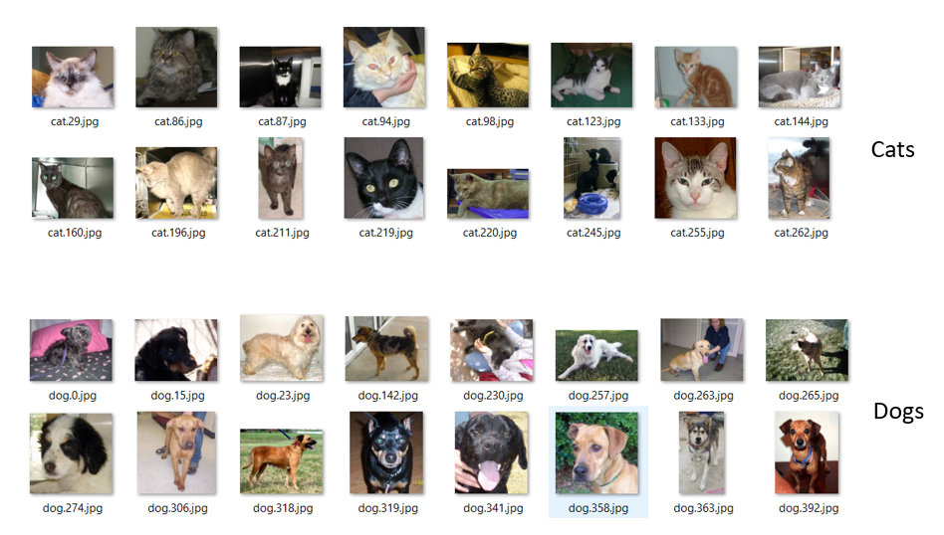
Dogs v/s Cats

Slide 8
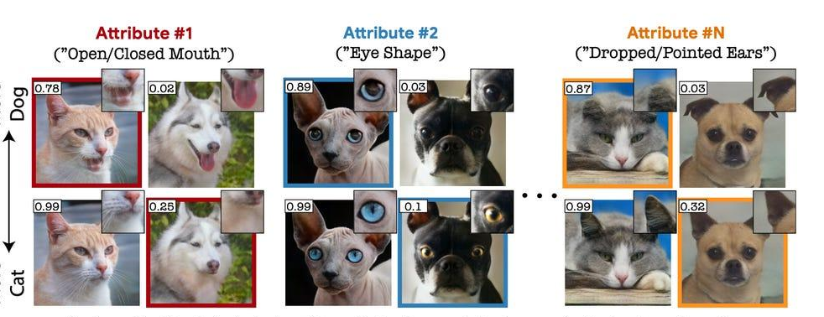

Slide 9

What is it? Cat or Dog?
Decision Factors
Animal | Fur Type | Tail Length | Ear Shape | Size
Dog | Short | Medium | Pointed | Medium
Cat | Long | Short | Pointed | Small

Slide 10

Is Data Science a new advancement?
No!
We have been doing this all our lives.

Slide 11
Need of data Science
Then what is it about Data Science that is new?
Why it became such a rage in the recent years?

Slide 12
Big Data
Every two days now we create as much information as we did from the dawn of civilization up until 2003, according to Schmidt. That’s something like five exabytes of data, he says.
Good news today is that technology today helps us to utilise this data.
-Eric Schmidt (Former Google CEO), 2010
Technological Advancements: The exponential growth in computing power, storage capacity, and data processing technologies has made it feasible to store, manage, and analyze massive volumes of data.
Proliferation of Digital Devices: The widespread use of smartphones, IoT devices, and sensors has led to an explosion in data generation.
Internet and Social Media: The internet and social media platforms have become integral parts of people's lives. These platforms generate enormous amounts of data through user interactions, content sharing, and online transactions.
E-commerce and Online Services: The growth of e-commerce, online services, and digital platforms has resulted in vast amounts of transactional and user behaviour data.

Slide 13
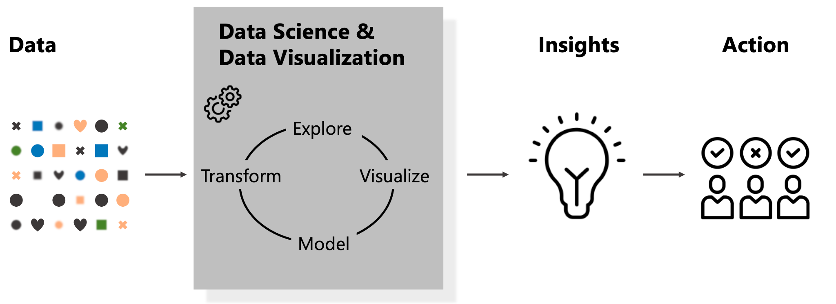
Automation

Slide 14


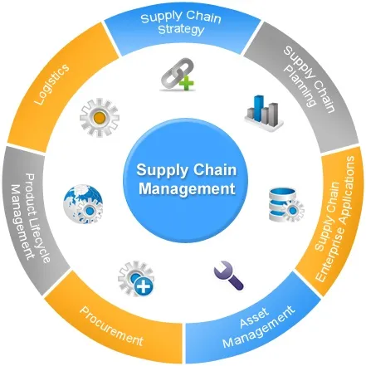
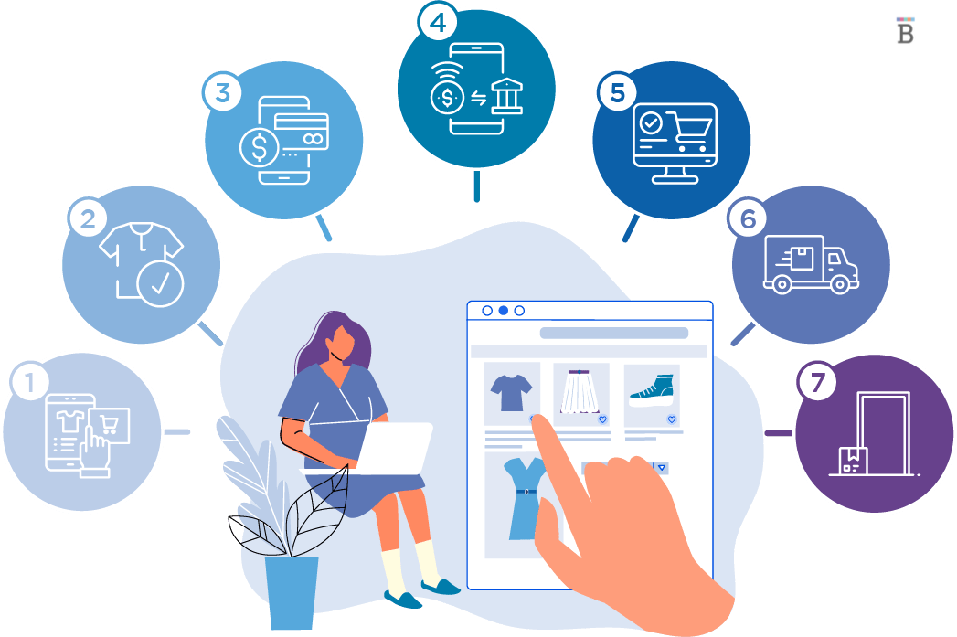
Business and Competitive Edge/
Scientific Research

Slide 15

Great Potential Unlocked

Slide 16
Areas of Application
Prediction
Classification: These are algorithms that assign an input data point to one of several predefined categories. For example, email spam classification or image classification.
Regression: These are algorithms that predict a continuous numerical value for a given input. For example, predicting the price of a house based on its features.
Clustering: These are algorithms that group similar data points into clusters. For example, segmenting customers into different groups based on their purchasing behavior.
Anomaly Detection: These are algorithms that identify data points that are significantly different from the norm. For example, detecting fraudulent transactions in a large dataset.
Recommender Systems: These are algorithms that suggest items to users based on their preferences or past behavior. For example, suggesting movies to watch or products to purchase.
Natural Language Processing (NLP): These are algorithms that process and analyze human language. For example, sentiment analysis of customer reviews or machine translation of written text.
Computer Vision: These are algorithms that process and analyze visual information. For example, object recognition in images or facial recognition in videos.
………..and many more.

Slide 17

Let's decode this by solving simple use cases !

Slide 18
Identify gender of a person given Name
Think of a female name ending with n !
Think of a female name ending with i !
Think of a male name ending with a !

Slide 19
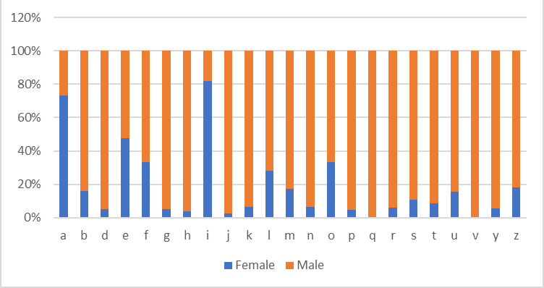

Slide 20
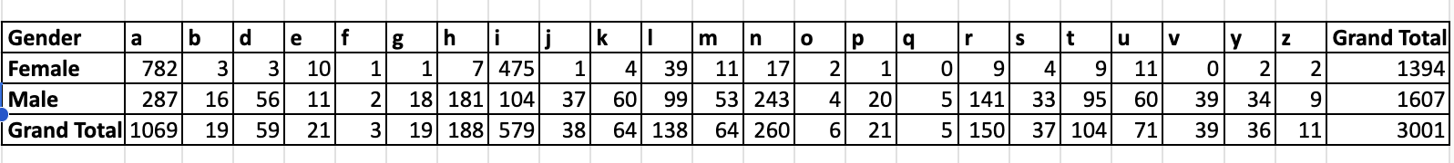

Slide 21
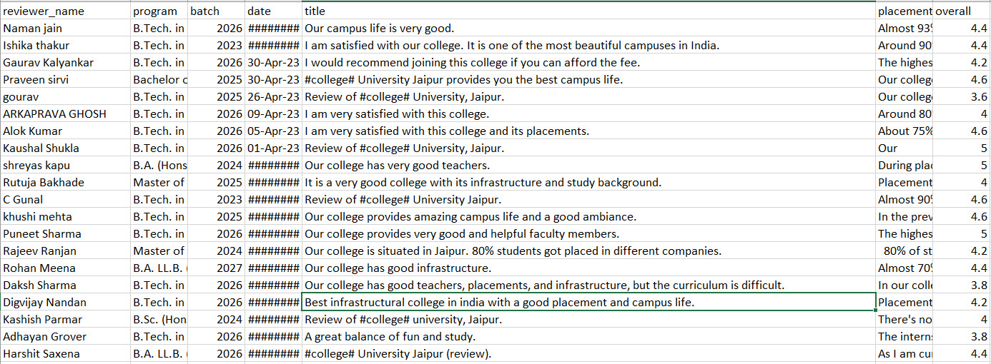
You want to choose a college for further studies.
Now look at what people are saying about it.

Slide 22
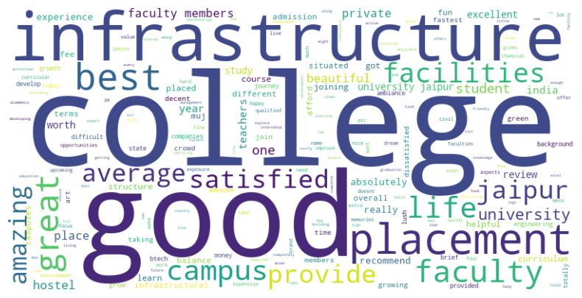
Solution !

Slide 23
Mrs/Mr Khanna started an online clothing shopping store. She wants to increase the sales.
Lets help her out in increasing her numbers.

Slide 24




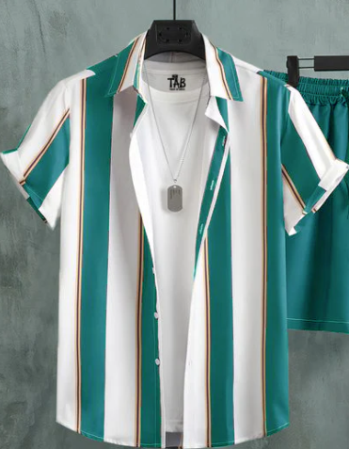




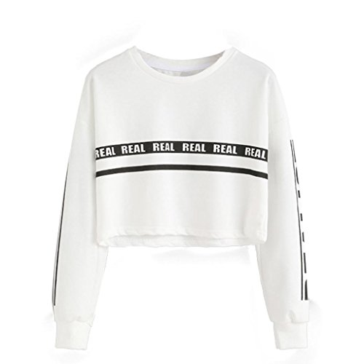




Product Catalogue
P001 | P002 | P003 | P004 | P005
P006 | P007 | P008 | P009 | P10
P10 | P12 | P13 | P14 | P15

Slide 25
OrderID | CustomerID | PurchaseDate (yy-mm-dd) | ProductID | Product | Quantity | UnitPrice
1001 | 101 | 27-06-2023 | P01 | Summer Cap | 2 | 100
1001 | 101 | 27-06-2023 | P02 | Sunglasses | 1 | 50
1002 | 102 | 28-07-2023 | P07 | Kurta |  | 150
1003 | 103 | 29-07-2023 | P03 | Half Sleeve T-shirt | 1 | 200
1003 | 103 | 29-07-2023 | P04 | Capri | 2 | 350
1004 | 104 | 31-08-2023 | P05 | Saree | 1 | 400
1004 | 104 | 31-08-2023 | P06 | Earrings | 1 | 30
1005 | 105 | 01-09-2023 | P03 | Half Sleeve T-shirt | 1 | 200
1005 | 105 | 01-09-2023 | P04 | Capri | 2 | 350
1006 | 105 | 02-09-2023 | P07 | Kurta | 2 | 150
1007 | 104 | 07-09-2023 | P05 | Saree | 2 | 400
1007 | 104 | 07-09-2023 | P06 | Earrings | 1 | 30
1008 | 106 | 05-10-2023 | P15 | Lahenga | 1 | 4000
1009 | 107 | 16-10-2023 | P14 | Sherwani | 1 | 2000
1010 | 108 | 26-10-2023 | P15 | Lahenga | 1 | 4000
1011 | 103 | 27-10-2023 | P03 | Half Sleeve T-shirt | 1 | 200
1011 | 103 | 29-07-2023 | P04 | Capri | 2 | 350
1012 | 109 | 27-10-2023 | P14 | Sherwani | 1 | 2000
1013 | 110 | 28-10-2023 | P15 | Lahenga | 1 | 4000
1014 | 111 | 29-10-2023 | P14 | Sherwani | 1 | 2000
1015 | 101 | 01-11-2023 | P10 | Sweatshirt | 2 | 250
1016 | 103 | 02-11-2023 | P11 | Long Sleeve T-shirt | 1 | 300
1016 | 103 | 02-11-2023 | P12 | Jeans | 1 | 600
1017 | 103 | 04-11-2023 | P13 | Thermocoat | 1 | 270
1018 | 101 | 05-11-2023 | P10 | Sweatshirt | 2 | 250
1019 | 105 | 06-11-2023 | P11 | Long Sleeve T-shirt | 1 | 300
1019 | 105 | 06-11-2023 | P12 | Jeans | 1 | 600
1020 | 106 | 10-12-2023 | P05 | Saree | 1 | 400
1020 | 106 | 10-12-2023 | P06 | Earrings | 1 | 30
1021 | 107 | 01-01-2024 | P11 | Long Sleeve T-shirt | 1 | 300
1021 | 107 | 01-01-2024 | P12 | Jeans | 1 | 600
1022 | 101 | 01-02-2024 | P09 | Winter Cap | 1 | 150
1022 | 101 | 01-02-2024 | P02 | Sunglasses | 1 | 50
1023 | 111 | 03-02-2024 | P09 | Winter Cap | 1 | 150
1023 | 111 | 03-02-2024 | P02 | Sunglasses | 1 | 50
ThankYou !
ThankYou !

Slide 26
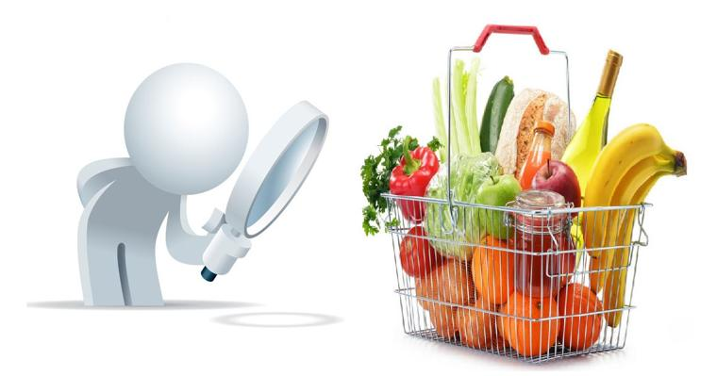
What all we can do?
Product Bundling
Seasonal Promotions
Customer Loyalty Programme
Personalized Targeting
Market Basket Analysis
Market basket analysis (also known as association analysis or affinity analysis) is a data mining and analytics technique used by retailers and businesses to discover patterns and relationships in customer purchase data.

Slide 27
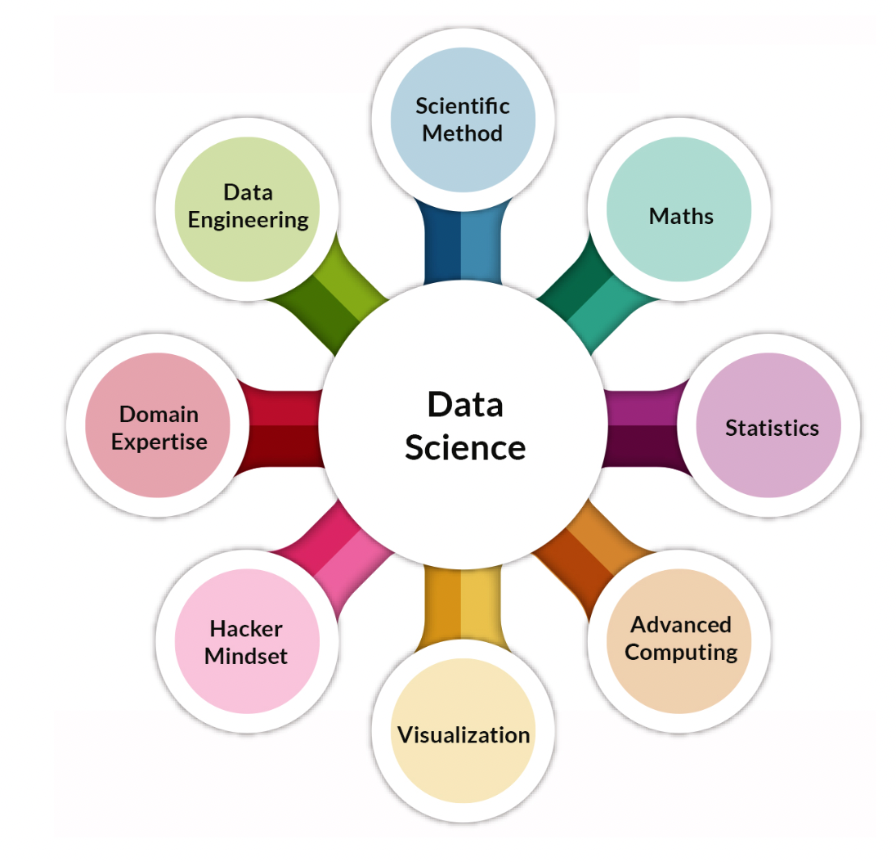
Components of Data Science
Data
Big Data
Domain Expertise
Data Engineering
Mathematics
Stats & Prob
ML
Programming Languages
Visualization and Operationalization
Advanced Computing
Data Analysis and Models
Development Tools

Slide 28
Data Science Life Cycle
Problem Definition:
Understand the business and define clear and measurable objectives for the data science project.
Data Collection:
Gather relevant data from various sources, such as databases, APIs, web scraping, and sensors.
Data Cleaning and Preprocessing:
Handle missing data, outliers, and inconsistencies in the dataset.
Transform and normalize data for analysis. Feature engineering: Create new features or modify existing ones to improve model performance.
Exploratory Data Analysis (EDA):
Visualize data to understand its distribution, relationships, and patterns.
Data Splitting:
Divide the dataset into training, validation, and test sets to evaluate models effectively.
Model Building:
Select appropriate machine learning algorithms or statistical models.
Model Validation and Selection:
Select the best-performing model(s) based on defined criteria.
Model Deployment:
Deploy the chosen model(s) for use in real-world applications.
Business Impact Assessment:
Assess the impact of the data science project on the business or organization.
Determine if the project's objectives have been met.
Documentation:
Maintain detailed documentation of the entire data science process, including code, models, and findings.
Feedback Loop:
Iterate on the process based on feedback, new data, or changing business needs.

Slide 29
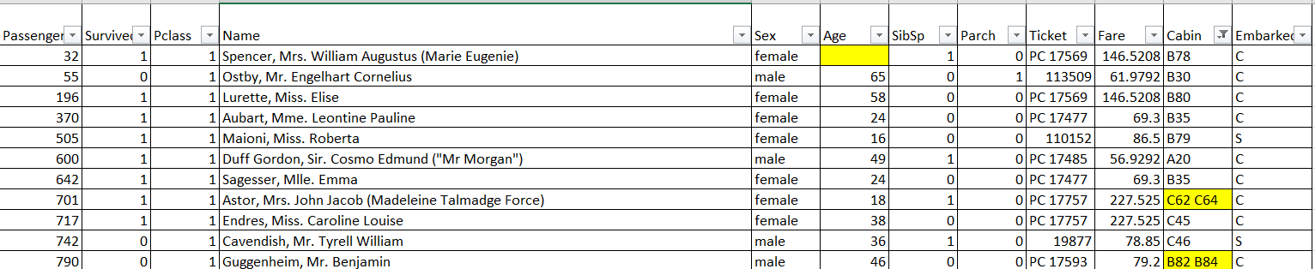
Example of Life Cycle
Understanding the Business Problem
Predicting survival of the passenger where 1 means survived.
Data Preparation
Data Cleaning -> Solving data entry errors and filling missing values.

Slide 30
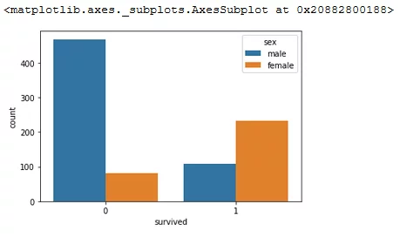
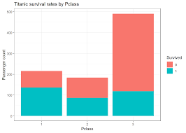
Exploratory Data Analysis
Data Modelling
Feature Engineering -> Deck from Cabin: Extract the deck or cabin letter from the Cabin column, if available. This can provide insights into a passenger's location on the ship.
Predictive Modelling
Model Evaluation
Model Deployment

Slide 31
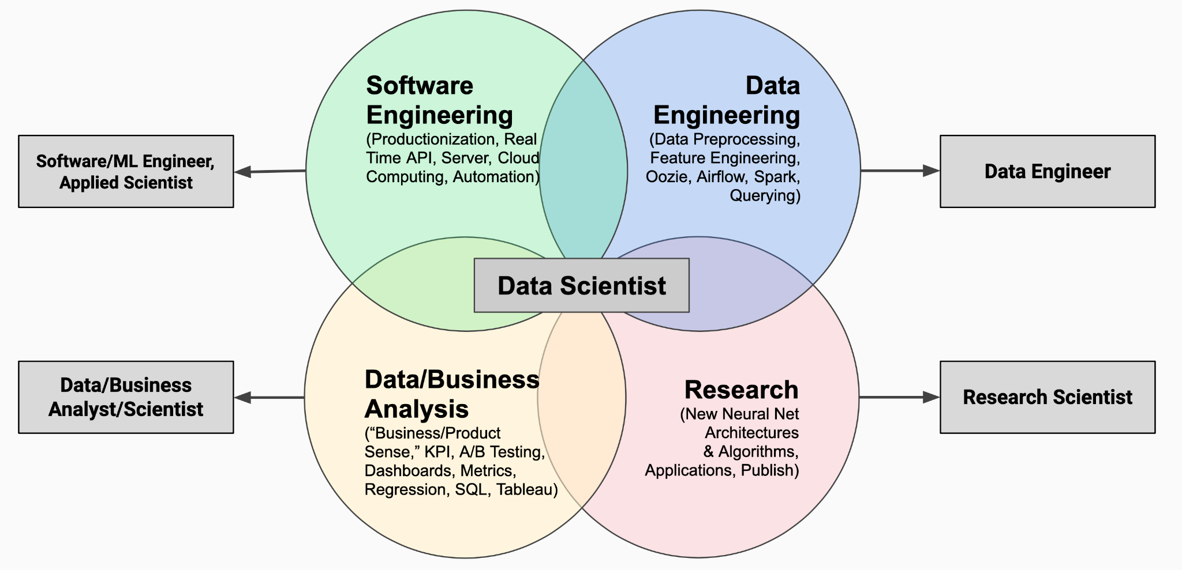
Market of Data Science

Slide 32
Topics | Data Analyst / Business Analyst | Data Analyst / Business Analyst | Data Scientist | Data Scientist
 | Entry Level | Higher Level | Entry Level | Higher Level
Excel | Expert | Expert | Expert | Expert
SQL | Intermediate - Expert | Expert - Proficient | Intermediate | Expert - Proficient
Python | No | Beginner | Expert | Proficient
Tableau / Power BI | Expert | Expert | Intermediate | No
Approximation Questions | Not mandatory | Expert | No | Yes
Machine Learning | No | Beginner | Expert | Proficient
Deep Learning | No | No | Depends on role | Depends on role

Slide 33
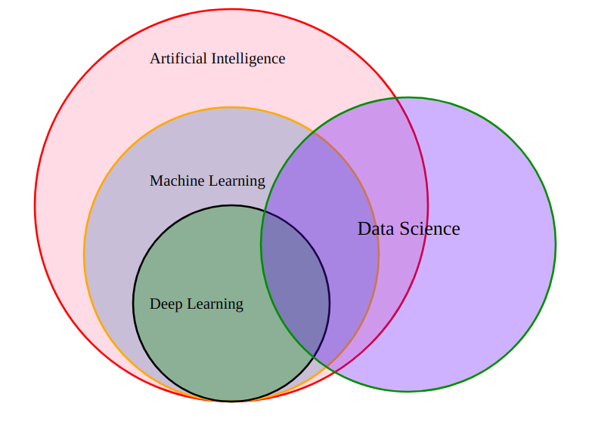
What do you understand by these Jargons ?
Artificial Intelligence
Data Science
Machine Learning
Deep Learning
Computer Vision
Natural Language Processing

Slide 34
Artificial Intelligence (AI): AI is like teaching computers to think and learn like people do. Computers can do things, make choices, and solve problems all by themselves!
Data Science: Data Science is when we use special computer tricks to look at a lot of information and find cool stuff that helps us understand things better. It's like being a detective for numbers!
Machine Learning (ML): Machine Learning is a type of computer learning where we show the computer many examples so it can learn and guess things on its own. It's like teaching a computer to guess if it will rain tomorrow.
Deep Learning: Deep Learning is a bit like Machine Learning, but it's even smarter. It uses computer networks that are good at finding really tricky patterns, like telling the difference between cats and dogs in pictures.

Slide 35
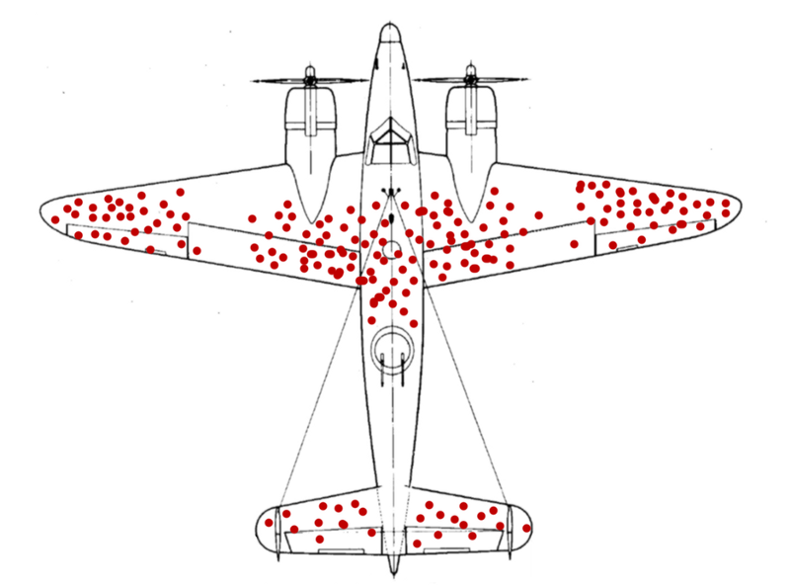
Rise of Data Analytics
Abraham Wald & the missing Bullet holes (World War II)
The missing bullet holes were on the missing planes.

Slide 36
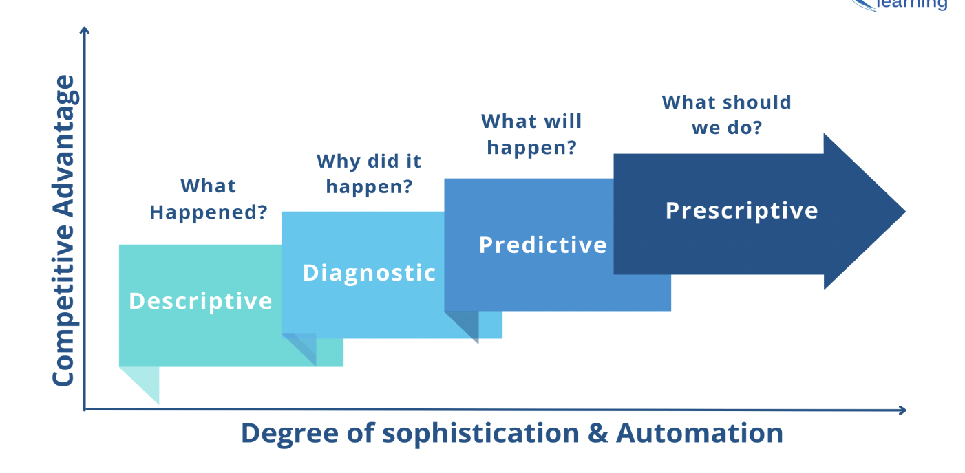
Types of Data Analytics

Slide 37
Data Analysis for Heart Disease
Descriptive : 70% People die of Heart Attack
Diagnostic : High Cholesterol Levels
Predictive : Adults below age of 30 are likely to witness Heart Problems
Prescriptive : Avoid Junk Food / Monitor Junk Food Outlets

Slide 38
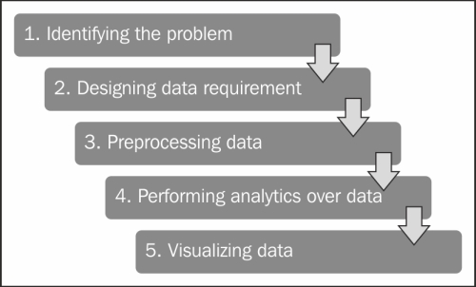
Data Analytics Lifecycle

Slide 39
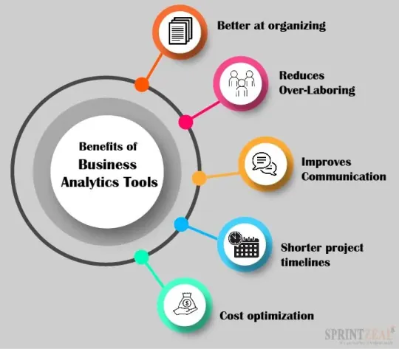
Need for Business Analytics

Slide 40
End

